Slide 1
CSC6103 – Virtualization Techniques
GPU Virtualiztion
Prof. Yeh-Ching Chung
School of Data Science
Chinese University of Hong Kong, Shenzhen

Slide 2
Agenda
Introduction GPGPU
High Performance Computing Clouds
GPU Virtualization with Hardware Support
References

Slide 3
Introduction GPGPU

Slide 4
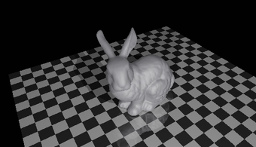
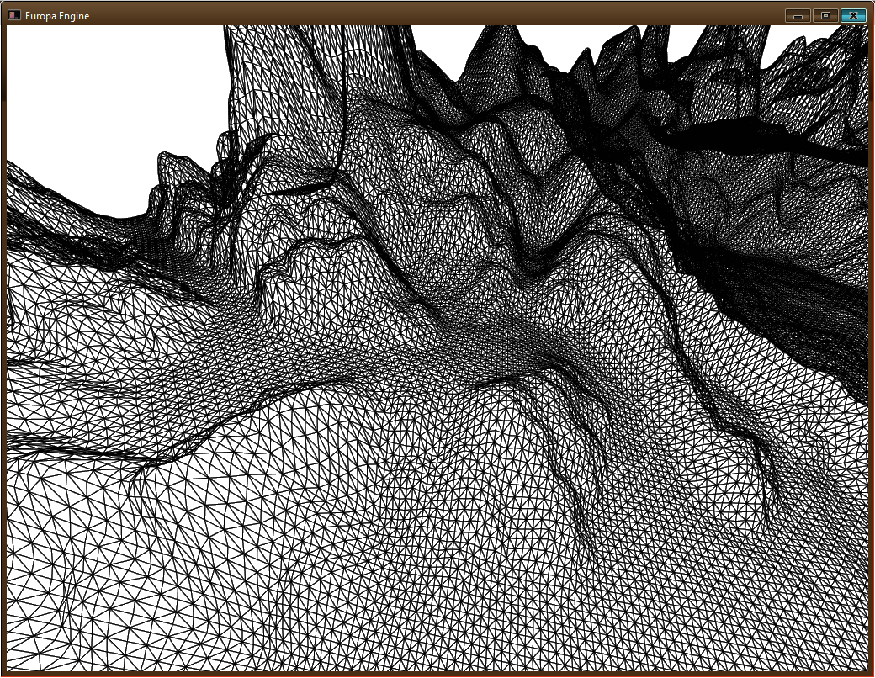
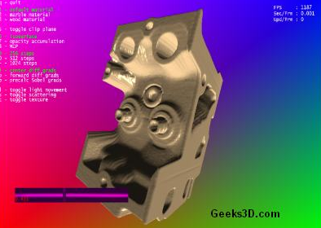
GPU
Graphics Processing Unit (GPU)
  Driven by the market demand for real-time and high-definition 3D graphics, the programmable Graphic Processor Unit (GPU) has evolved into a highly parallel, multithreaded, many core processor with tremendous computational power and very high memory bandwidth

Slide 5
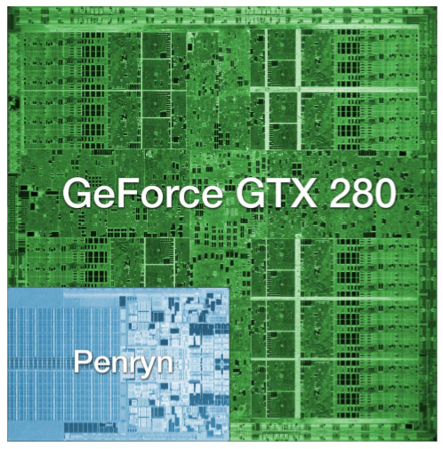
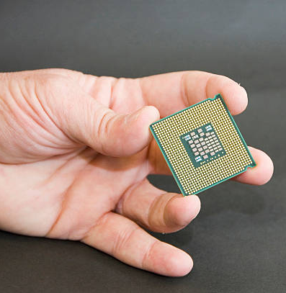
How Much Computation?
NVIDIA GeForce GTX 280: 1.4 billion transistors
Intel Core 2 Duo:291 million transistors
Notes:
-Modern GPUs have more transistors, draw more power, and offer at least an order of magnitude more compute power than CPUs
-That’s a lot of wasted computation potential in virt solutions which don’t support the GPU.

Slide 6
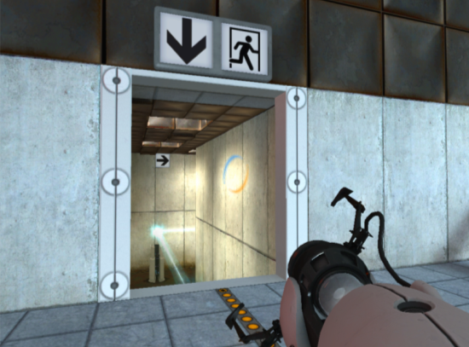
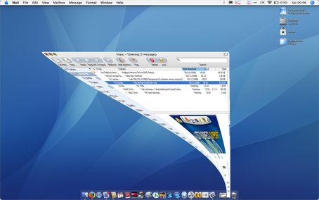
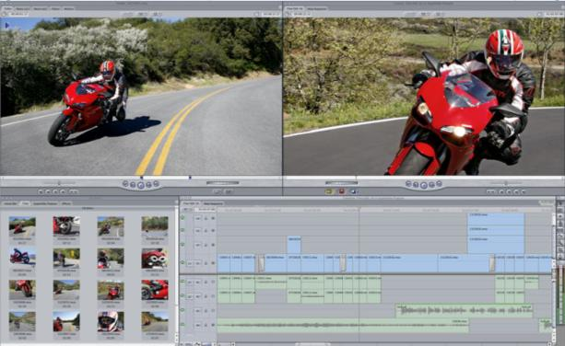
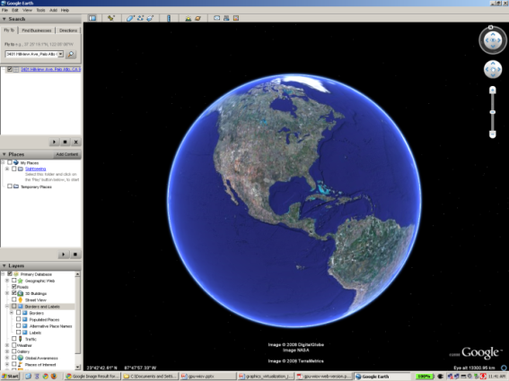
What Are GPUs Good for?
Desktop Apps
  Entertainment
  CAD
  Multimedia
  Productivity
Desktop GUIs
  Quartz Extreme
  Vista Aero
  Compiz
Notes:
-GPU technology is largely being driven by games
-But they’re also used by CAD apps, productivity apps like Google Earth, video processing
-And now, Windows, Mac OS, and Linux all have a user interface which supports GPU acceleration

Slide 7
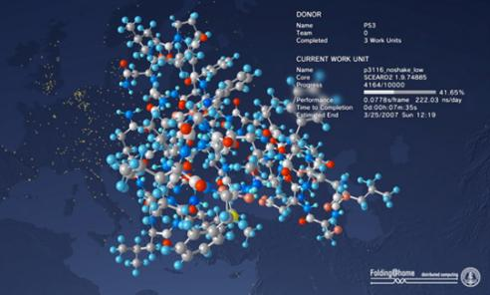
GPUs in the Data Center
Server-hosted Desktops
GPGPU
Notes:
-GPUs are currently most important on the desktop
- The use cases are consumer apps (Windows games on Mac), professional apps, and GPU-accelerated windowing systems
- This means that the most immediate need is for a hosted solution: coexists with the user’s existing OS
-But GPUs in the data center are also expected to emerge as an important solution space
- GPGPU apps (scientific, financial)
- Server-hosted virtual desktops

Slide 8
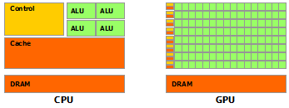
CPU vs. GPU (1)
Reasons behind the discrepancy between the CPU and the GPU
  The GPU is specialized for compute-intensive, highly parallel computation.
  The GPU is designed for data processing rather than data caching and flow control

Slide 9
CPU vs. GPU (2)
GPU is especially well-suited for data-parallel computations
  The same program is executed on many data elements in parallel
  Lower requirement for sophisticated flow control
  Execute on many data elements and is arithmetic intensity
  The memory access latency can be overlapped with calculations instead of big data caches

Slide 10
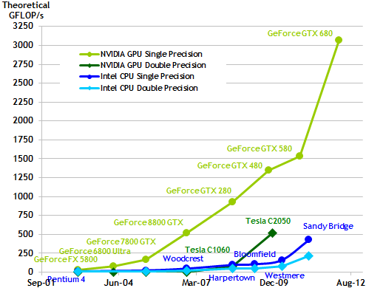
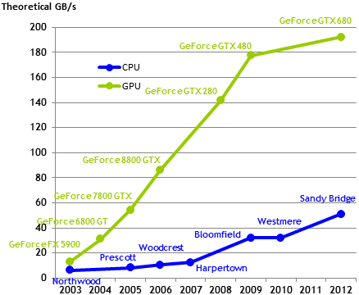
CPU vs. GPU (3)
The performance comparisons of CPU and GPU in terms of floating-point operation and memory bandwidth
Floating-Point Operations per Second
Memory Bandwidth

Slide 11
GPGPU
The general-purpose graphic processing unit (GPGPU) is the utilization of GPUs to perform computations that are traditionally handled by the CPUs
GPU with a complete set of operations performed on arbitrary bits can compute any computable value

Slide 12
GPGPU Computing Scenarios
Low-level of data parallelism
  No GPU is needed, just proceed with the traditional HPC strategies
High-level of data parallelism
  Add one or more GPUs to every node in the system and rewrite applications to use them
Moderate-level of data parallelism
  The GPUs in the system are used only for some parts of the application,
  Remain idle the rest of the time and, thus waste resources and energy
Applications for multi-GPU computing
  The code running in a node can only access the GPUs in that node, but it would run faster if it could have access to more GPUs

Slide 13
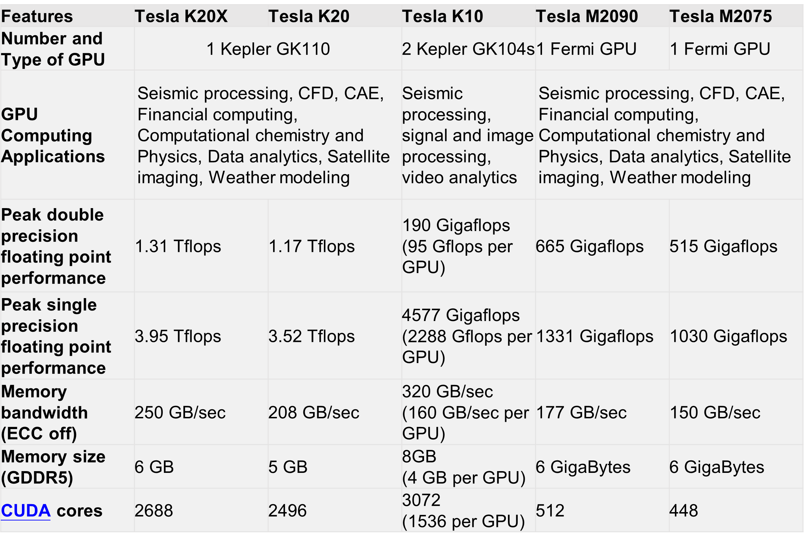
NVIDIA GPGPUs

Slide 14
NVIDIA K20 Series (1)
NVIDIA Tesla K-series GPU Accelerators are based on the NVIDIA Kepler compute architecture that includes
  SMX (streaming multiprocessor) design that delivers up to 3x more performance per watt compared to the SM in Fermi
  Dynamic Parallelism capability that enables GPU threads to automatically spawn new threads
  Hyper-Q feature that enables multiple CPU cores to simultaneously utilize the CUDA cores on a single Kepler GPU

Slide 15
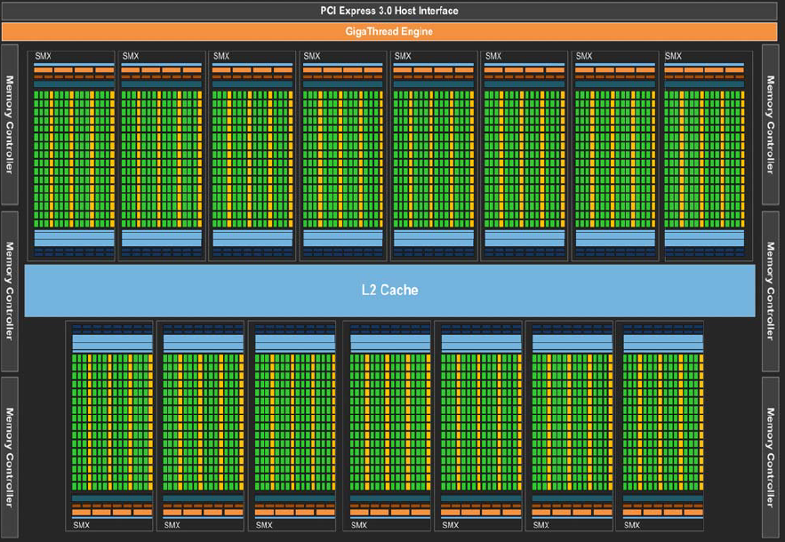
NVIDIA K20 Series (2)
NVIDIA Tesla K20 (GK110) Block Diagram

Slide 16
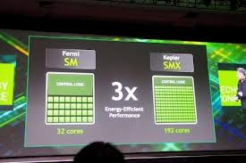
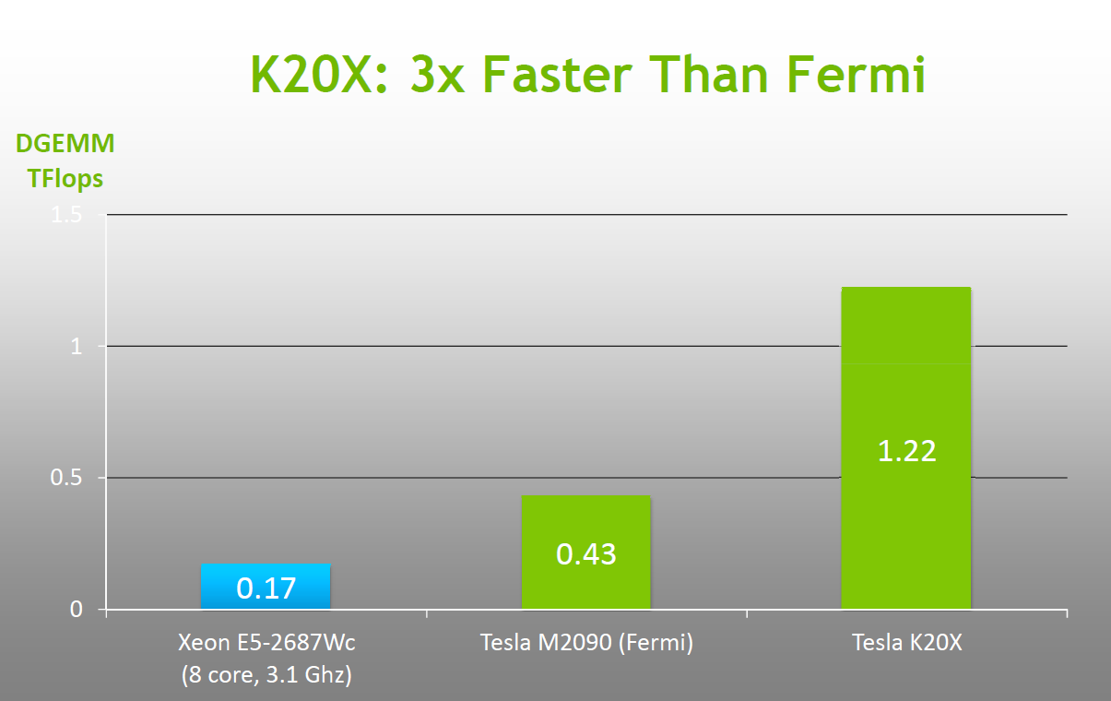
NVIDIA K20 Series (3)
SMX (streaming multiprocessor) design that delivers up to 3x more performance per watt compared to the SM in Fermi

Slide 17
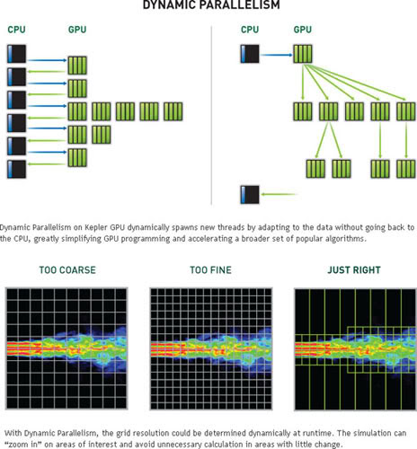
NVIDIA K20 Series (4)
Dynamic Parallelism

Slide 18
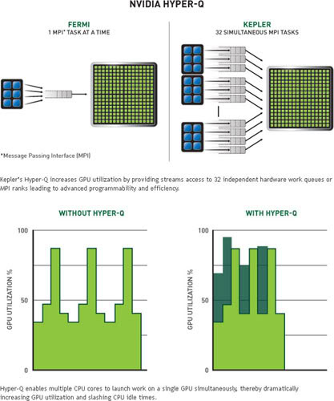
NVIDIA K20 Series (5)
Hyper-Q Feature

Slide 19

GPGPU TOOLS
Two main approaches in GPGPU computing development environments
CUDA
  NVIDIA proprietary
OpenCL
  Open standard

Slide 20
High Performance Computing clouds

Slide 21
High Performance Computing Clouds (1)
Fast interconnects
Hundreds of nodes, with multiple cores per node
Hardware accelerators
  better performance-watt, performance-cost ratios for certain applications
How to achieve the High Performance Computing?
App
App
App
GPU array
App
App
App
App
App
App
App
App

Slide 22
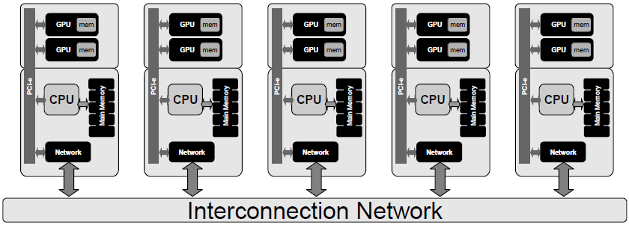
High Performance Computing Clouds (2)
Add GPUs at each node
  Some GPUs may be idle for long periods of time
  A waste of money and energy

Slide 23
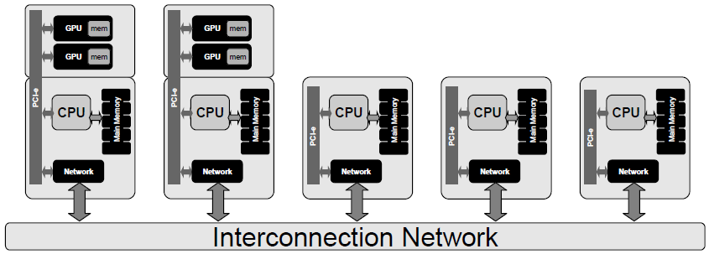
High Performance Computing Clouds (3)
Add GPUs at some nodes
  Lack flexibility

Slide 24
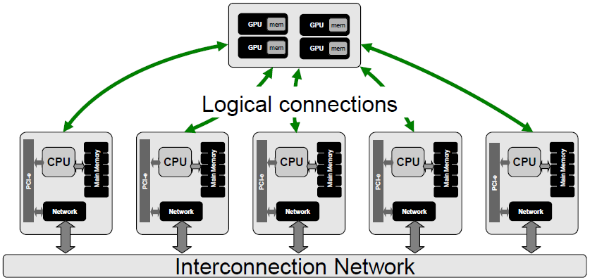
High Performance Computing Clouds (4)
Add GPUs at some nodes and make them accessible from every node (GPU virtualization)
How to achieve it?

Slide 25
GPU Virtualization Overview
GPU device is under control of the hypervisor
GPU access is routed via the front-end/back-end
The management component controls invocation and data movement
VM
VM
VM
vGPU
vGPU
vGPU
VM
VM
VM
front-end
front-end
front-end
vGPU
vGPU
vGPU
front-end
front-end
front-end
Hypervisor
Hypervisor
Host OS
back-end
back-end
Device(GPU)
Device(GPU)
※Hypervisor independent

Slide 26
Interface Layers Design
Normal GPU Component Stack
Split the stack into hardware and software binding
User Application
User Application
GPU Driver API
GPU Driver
GPU Enabled Device
GPU Driver API
soft binding
direct communication
We can cheat the application!
GPU Driver
GPU Enabled Device
hard binding

Slide 27
Architecture
Re-group the stack into host and remote side
User Application
vGPU Driver API
remote binding
(guest OS)
Front End
Communicator (network)
Back End
GPU Driver API
host binding
GPU Driver
GPU Enabled Device

Slide 28
Key Components (1)
vGPU Driver API
  A fake API as adapter to adapt the instant driver and the virtual driver
  Run on guest OS kernel mode
Front End
  API interception
    parameters passed
    order semantics
  Pack the library function invocation
  Send packs to the back end
  Interact with the GPU library (GPU driver ) by terminating the GPU operation
  Provide results to the calling program
User Application
vGPU Driver API
Front End
communicator
Back End
GPU Driver API
GPU Driver
GPU Enabled Device

Slide 29
Key Components (2)
Communicator
  Provide a high performance communication between VM and host
Back End
  Deal with the hardware using the GPU driver
  Unpack the library function invocation
  Map memory pointers
  Execute the GPU operations
  Retrieve the results
  Send results to the front end using the communicator
User Application
vGPU Driver API
Front End
communicator
Back End
GPU Driver API
GPU Driver
GPU Enabled Device

Slide 30
Communicator
The choice of the hypervisor deeply affects the efficiency of the communication
Communication may be a bottleneck
Platform | Communicator | Note
Generic | Unix Sockets, TCP/IP, RPC | Hypervisor independent
Xen | XenLoop | Provide a communication library between guest and host machines Implement low latency and wide bandwidth TCP/IP and UDP connections Application transparent and offers an automatic discovery of the supported VMS
VMware | VM Communication Interface (VMCI) | Provide a datagram API to exchange small messages A shared memory API to share data, an access control API to control which resources a virtual machine can access A discovery service for publishing and retrieving resources.
KVM/QEMU | VMchannel | Linux kernel module now embedded as a standard component Provide a high performance guest/host communication Based on a shared memory approach.

Slide 31
Lazy Communication
Reduce the overhead of switching between host OS and guest OS
Instant API: whose executions have immediate effects on the state of GPU hardware, ex: GPU memory allocation
Non-instant API: which are side-effect free on the runtime state, ex: setup GPU arguments
User Application
vGPU Driver API
Front End
(API interception)
Instant API call
communication
Back End
GPU Driver API
NonInstant API call
GPU Driver
GPU Enabled Device
NonInstant API Buffer

Slide 32
Walkthrough (1)
  A fake API as adapter to adapt the instant driver and the virtual driver
guest
host
User Application
Back End
vGPU Driver API
GPU Driver API
Front End
GPU Driver
GPU Enabled Device
communicator

Slide 33
Walkthrough (2)
  API interception
  Pack the library function invocation
  Sends packs to the back end
guest
host
User Application
Back End
vGPU Driver API
GPU Driver API
Front End
GPU Driver
GPU Enabled Device
communicator

Slide 34
Walkthrough (3)
  Deal with the hardware using the GPU driver
  Unpack the library function invocation
guest
host
User Application
Back End
vGPU Driver API
GPU Driver API
Front End
GPU Driver
GPU Enabled Device
communicator

Slide 35
Walkthrough (4)
  Map memory pointers
  Execute the GPU operations
guest
host
User Application
Back End
vGPU Driver API
GPU Driver API
Front End
GPU Driver
GPU Enabled Device
communicator

Slide 36
Walkthrough (5)
  Retrieve the results
  Send results to the front end using the communicator
guest
host
User Application
Back End
vGPU Driver API
GPU Driver API
Front End
GPU Driver
GPU Enabled Device
communicator

Slide 37
Walkthrough (6)
  Interact with the GPU library (GPU driver ) by terminating the GPU operation
  Provide results to the calling program
guest
host
User Application
Back End
vGPU Driver API
GPU Driver API
Front End
GPU Driver
GPU Enabled Device
communicator

Slide 38
GPU Virtualization Taxonomy (1)
API Remoting
Device Emulation
Front-end
Hybrid
(Driver VM)
Back-end
Fixed Pass-through
1:1
Mediated Pass-through
1:N

Slide 39
GPU Virtualization Taxonomy (2)
Major distinction is based on where we cut the driver stack
  Front-end: Hardware-specific drivers are in the VM
    Good portability, mediocre speed
  Back-end: Hardware-specific drivers are in the host or hypervisor
    Bad portability, good speed

Slide 40
GPU Virtualization Taxonomy (3)
Back-end: Fixed vs. Mediated
  Fixed: one device, one VM. Easy with an IOMMU
  Mediated: Hardware-assisted multiplexing, to share one device with multiple VMs
    Requires modified GPU hardware/drivers (Vendor support)
Front-end
  API remoting: replace API in VM with a forwarding layer. Marshall each call, execute on host
  Device emulation: Exact emulation of a physical GPU
There are also hybrid approaches: For example, a driver VM using fixed pass-through plus API remoting

Slide 41





API Remoting (1)
Time-sharing real device
Client-server architecture
Analogous to full paravirtualization of a TCP offload engine
Hardware varied by vendors, it is not necessary for VM-developer to implements hardware drivers for them

Slide 42
API Remoting (2)
Guest
Host
App
App
App
RPC Endpoint
User-level
API
OpenGL / Direct3D Redirector
OpenGL / Direct3D
API
GPU Driver
Kernel
GPU
Hardware
Notes:
The simplest approach... (one extreme)
Analogous to full paravirtualization of a TCP offload engine.
Easy, but you get what you pay for.
Pro:
Easy to get working
easy to support new APIs/features
Con:
Hard to make performant (Where do objects live? When to cross RPC boundary? Caches? Batching?)
VM Goodness (checkpointing, portability) is really hard
Who’s using it?
Parallels’ initial GL implementation
Remote rendering: GLX, Chromium project
Open source “VMGL”: OpenGL on VMware and Xen
http://www.cs.toronto.edu/~andreslc/xen-gl/

Slide 43
API Remoting (3)
Pro
  Easy to get working
  Easy to support new APIs/features
Con
  Hard to make performance (Where do objects live? When to cross RPC boundary? Caches? Batching?)
  VM Goodness (checkpointing, portability) is really hard
Who’s using it?
  Parallels’ initial GL implementation
  Remote rendering: GLX, Chromium project
  Open source “VMGL”: OpenGL on VMware and Xen

Slide 44

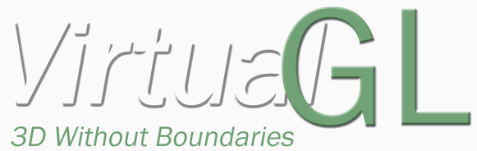
Related work
These are downloadable and can be used
  rCUDA
    http://www.rcuda.net/
  vCUDA
    http://hgpu.org/?p=8070
  gVirtuS
    http://osl.uniparthenope.it/projects/gvirtus/
  VirtualGL
    http://www.virtualgl.org/

Slide 45
Other Issues
The concept of “API Remoting” is simple, but implementation is cumbersome.
Engineers have to maintain all APIs to be emulated, but API spec may change in the future.
There are many different APIs related to GPU. Example: OpenGL, DirectX, CUDA, OpenCL…
  VMware View 5.2 vSGA support DirectX
  rCUDA support CUDA
  VirtualGL support OpenGL

Slide 46
Device Emulation (1)
Fully virtualize an existing physical GPU
Like API remoting, but Back-end have to maintain GPU resources and GPU state
Guest
Host
GPU Emulator
Resource Management
User-level
App
App
App
Shader / State Translator
Rendering Backend
API
OpenGL / Direct3D
OpenGL / Direct3D
API
Kernel
Virtual GPU Driver
GPU Driver
Kernel
Virtual HW
Virtual GPU
GPU
Hardware
Shared System
Memory

Slide 47
Device Emulation (2)
Pro
  Easy interposition (debugging, checkpointing, portability)
  Thin and idealized interface between guest and host
  Great portability
Con
  Extremely hard, inefficient
  Very hard to emulate a real GPU
  Moving target- real GPUs change often
  At the mercy of vendor’s driver bugs

Slide 48
Fixed Pass-Through (1)
Use VT-d to virtualize memory
VM accesses GPU MMIO directly
GPU accesses guest memory directly
Example
  Citrix XenServer
  VMware ESXi
Virtual Machine
OpenGL / Direct3D / Compute
App
App
App
API
GPU Driver
Pass-through GPU
DMA
MMIO
IRQ
PCI
VT-d
Physical GPU

Slide 49
Fixed Pass-Through (2)
Pro
  Native speed
  Full GPU feature set available
  Should be extremely simple
  No drivers to write
Con
  Need vendor-specific drivers in VM
  No VM goodness: No portability, no checkpointing
    (Unless you hot-swap the GPU device...)
  The big one: One physical GPU per VM
    Can’t even share it with a host OS

Slide 50
Mediated Pass-Through (1)
Similar to “self-virtualizing” devices, may or may not require new hardware support
Some GPUs already do something similar to allow multiple unprivileged processes to submit commands directly to the GPU
The hardware GPU interface is divided into two logical pieces
  One piece is virtualizable, and parts of it can be mapped directly into each VM.
    Rendering, DMA, other high-bandwidth activities
  One piece is emulated in VMs, and backed by a system-wide resource manager driver within the VM implementation.
    Memory allocation, command channel allocation, etc.
    (Low-bandwidth, security/reliability critical)

Slide 51
Mediated Pass-Through (2)
Virtual Machine
Virtual Machine
OpenGL / Direct3D / Compute
OpenGL / Direct3D / Compute
App
App
App
App
App
App
API
API
GPU Driver
GPU Driver
Pass-through GPU
Pass-through GPU
Emulation
Emulation
GPU Resource Manager
Physical GPU

Slide 52
Mediated Pass-Through (3)
Pro
  Like fixed pass-through, native speed and full GPU feature set
  Full GPU sharing
  Good for VDI workloads
  Relies on GPU vendor hardware/software
Con
  Need vendor-specific drivers in VM
  Like fixed pass-through, “VM goodness” is hard

Slide 53
GPU virtualization with hardware support

Slide 54
GPU Virtualization with Hardware Support (1)
Single Root I/O Virtualization (SR-IOV)
  SR-IOV supports native I/O virtualization in existing single root complex PCI-E topologies.
Multi-root I/O Virtualization (MR-IOV)
  MR-IOV supports native IOV in new topologies (e.g., blade servers) by building on SR-IOV to provide multiple root complexes which share a common PCI-E hierarchy

Slide 55
GPU Virtualization with Hardware Support (2)
SR-IOV have two major components
  Physical Function(PF) is a PCI-E function of a device, includes the SR-IOV Extended Capability in the PCI-E Configuration space.
  Virtual Function(VF) is associated with the PCI-E Physical Function, represents a virtualized instance of a device.
VM
VM
VM
VF driver
VF driver
VF driver
Hypervisor
PF driver
Host OS
Device(GPU)
PF
VF
VF
VF

Slide 56
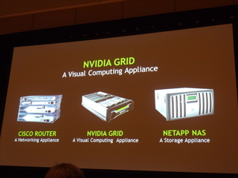
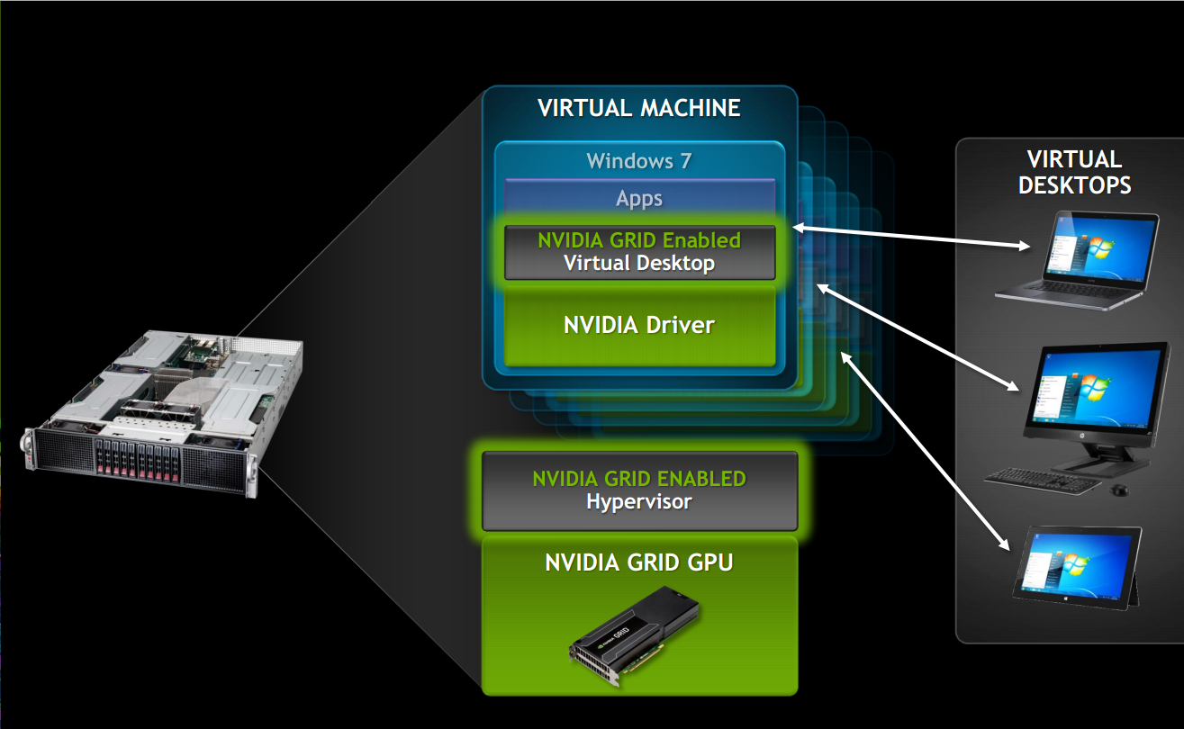
NVIDIA Approach
NVIDIA GRID BOARDS
  NVIDIA’s Kepler-based GPUs allow hardware virtualization of the GPU
  A key technology is VGX Hypervisor. It allows multiple virtual machines to interact directly with a GPU, manages the GPU resources, and improves user density

Slide 57
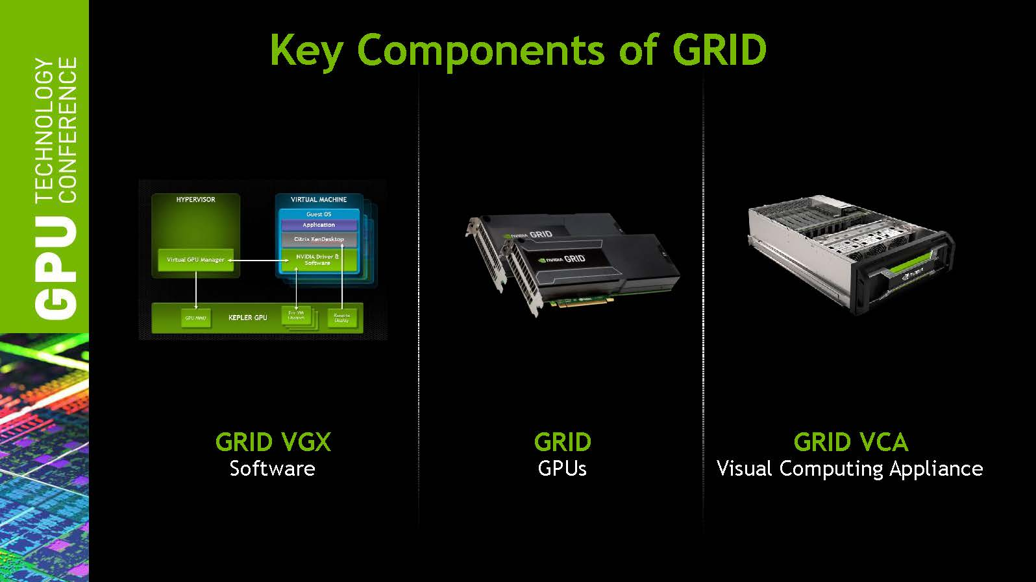
Key Components of GRID (1)

Slide 58
Key Component of Grid (2)
GRID VGX Software

Slide 59
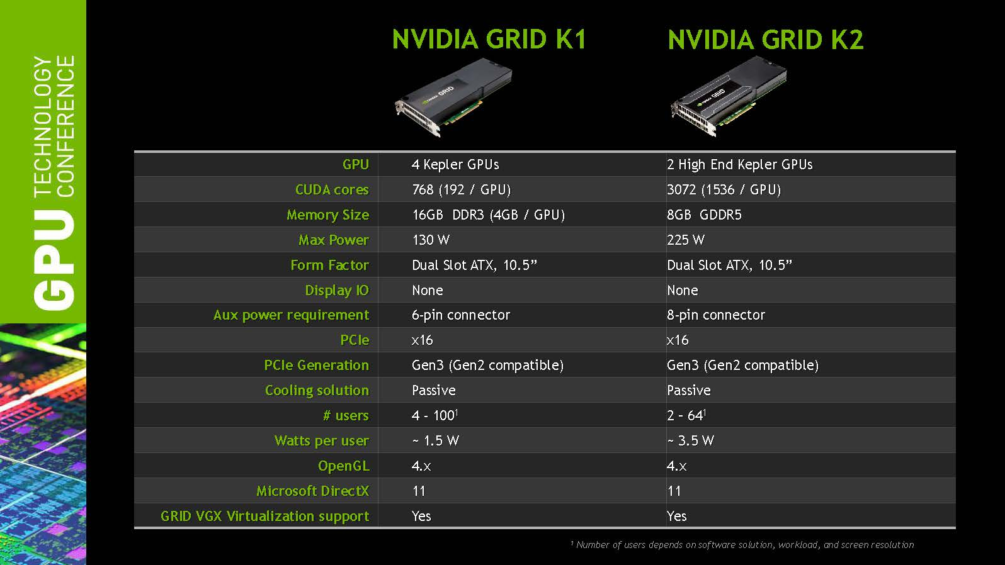
Key Component of Grid (3)
GRID GPU

Slide 60
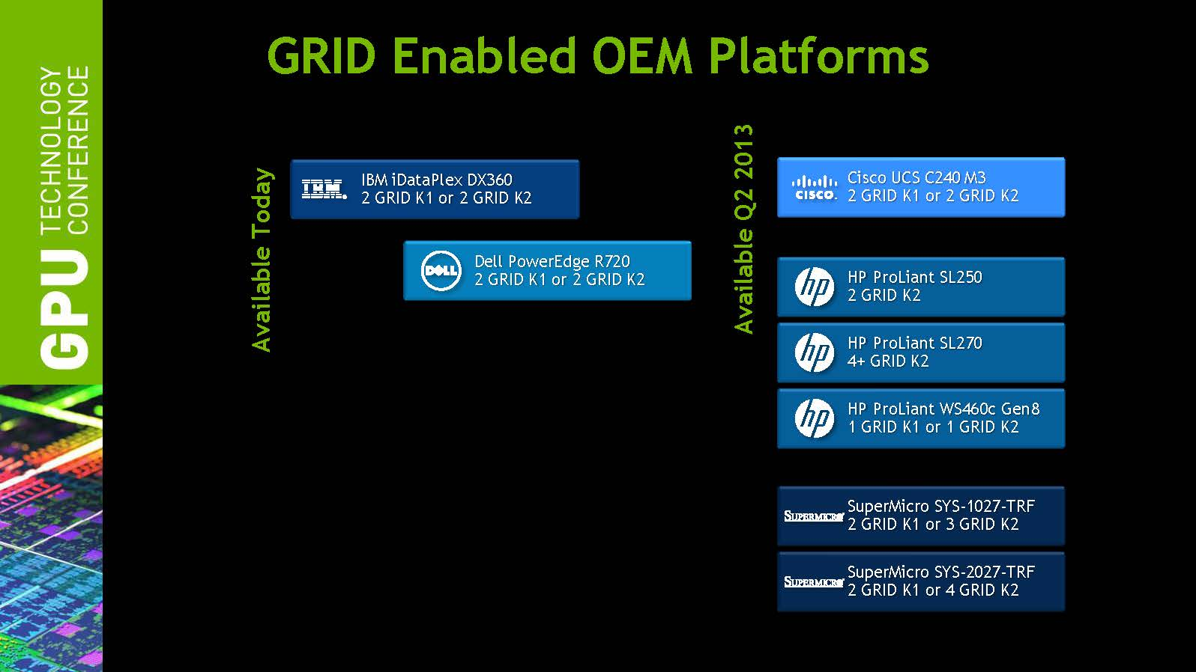
Key Component of Grid (4)
GRID Visual Computing Appliance (VCA)

Slide 61
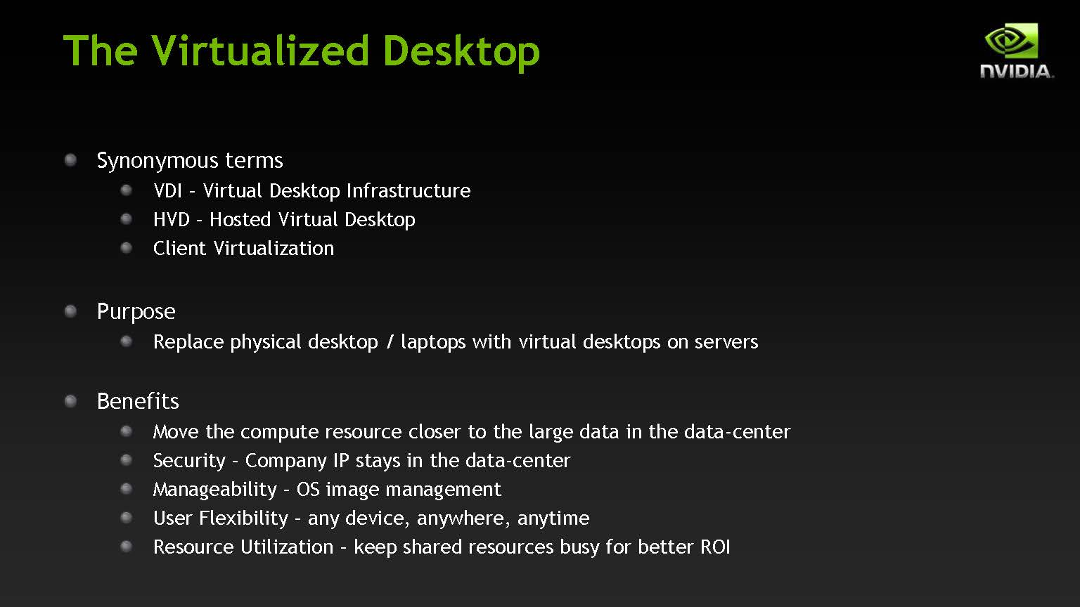
Desktop Virtualization (1)

Slide 62
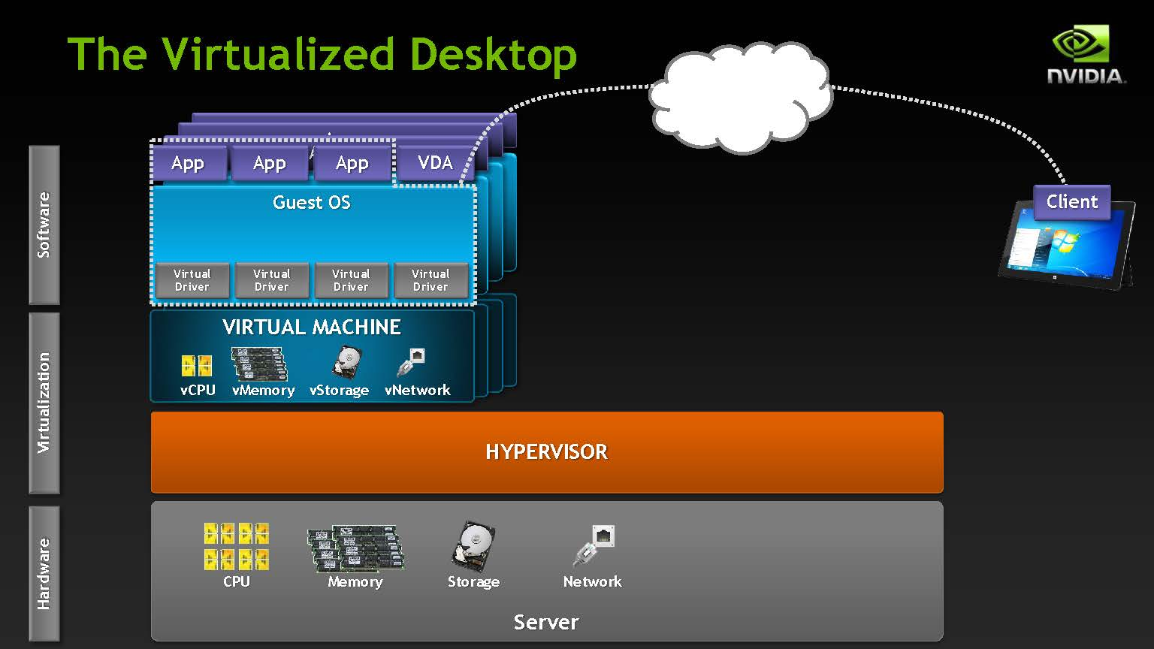
Desktop Virtualization (2)

Slide 63
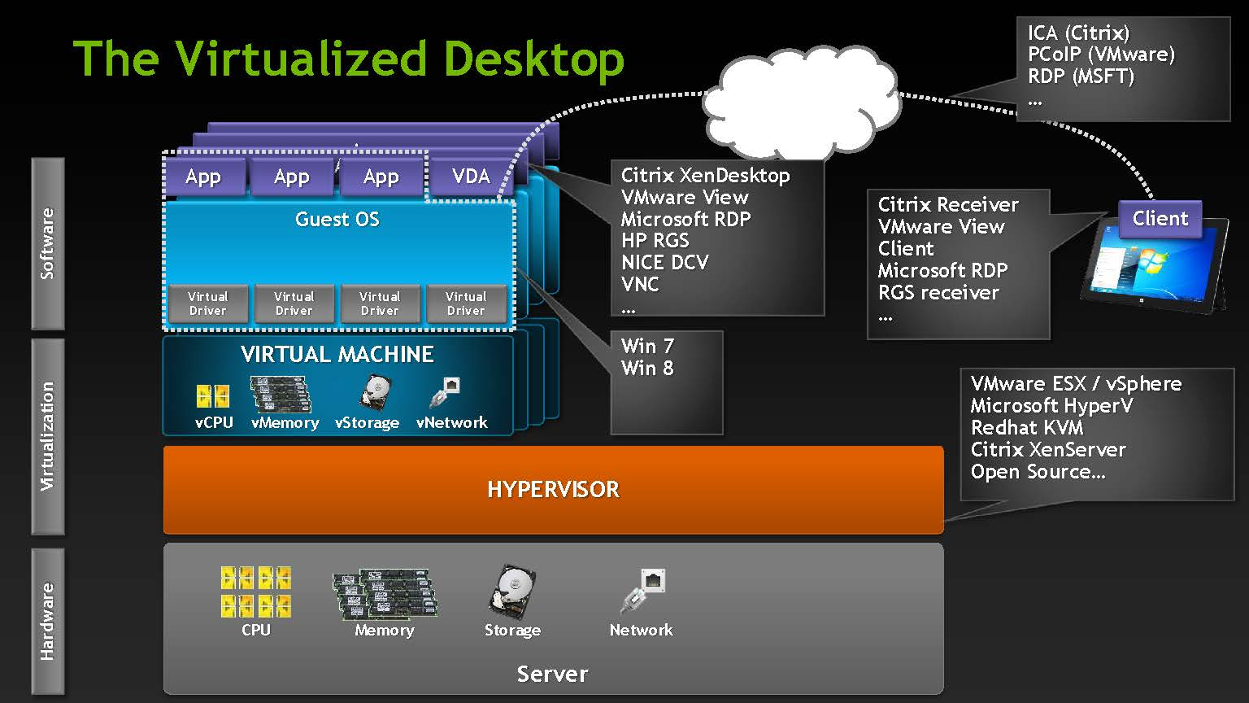
Desktop Virtualization (3)

Slide 64
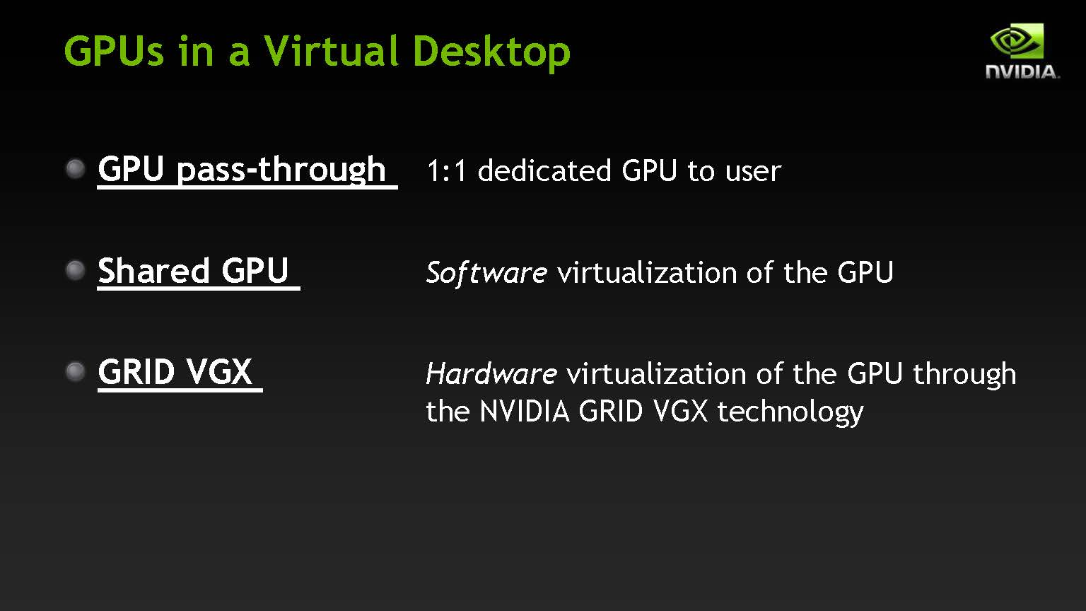
Desktop Virtualization Methods (1)

Slide 65
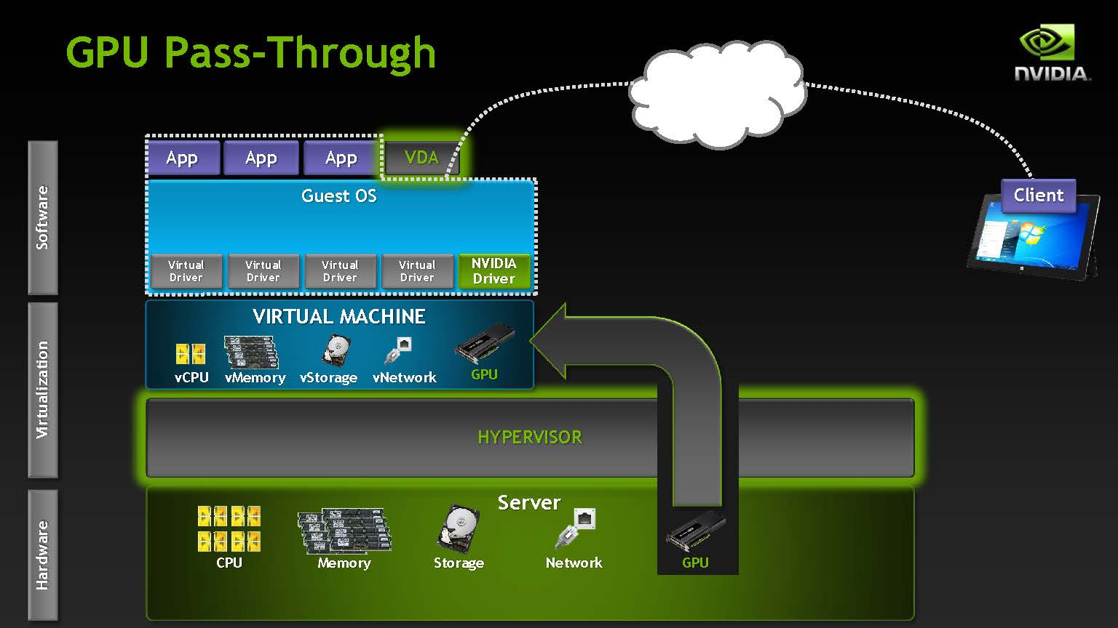
Desktop Virtualization Methods (2)

Slide 66
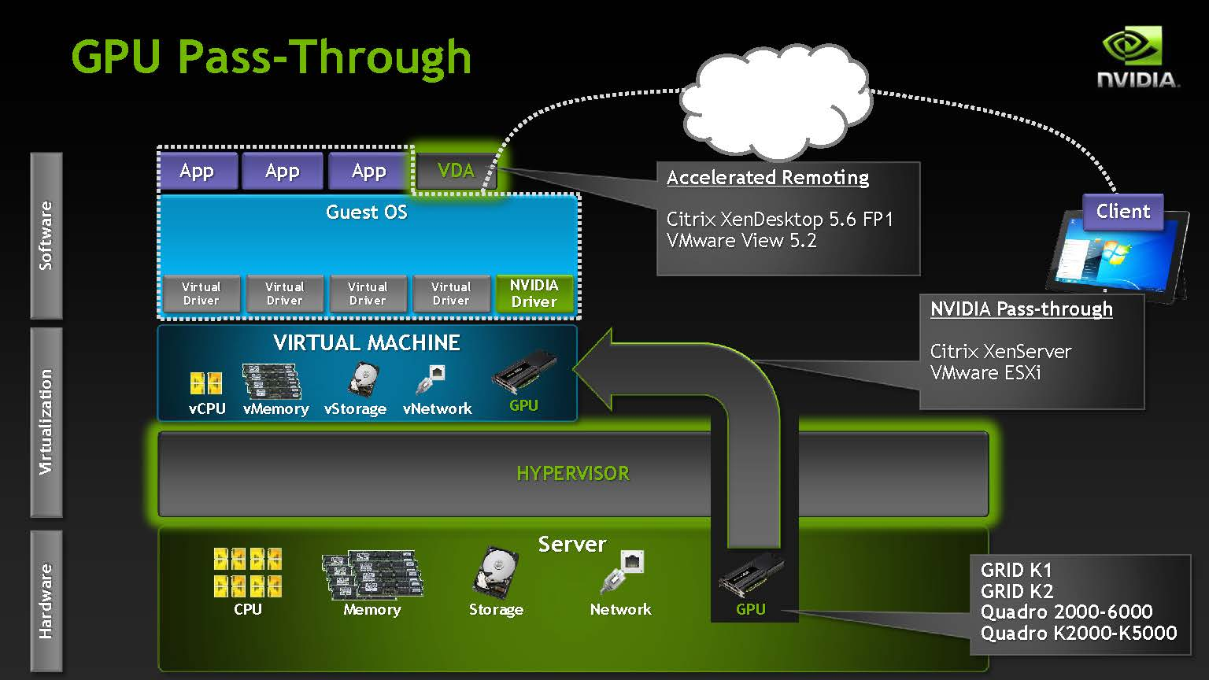
Desktop Virtualization Methods (3)

Slide 67
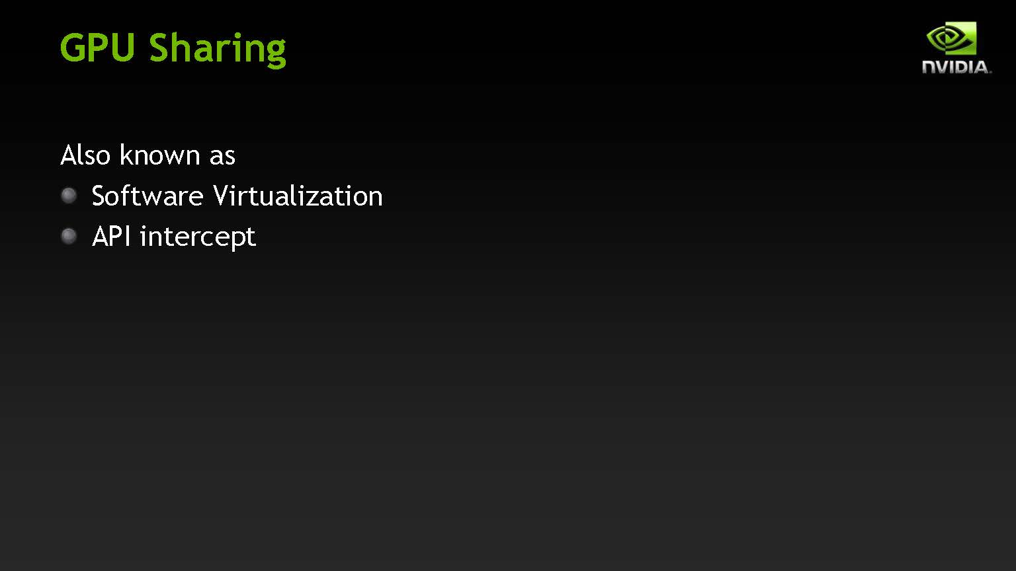
Desktop Virtualization Methods (4)

Slide 68
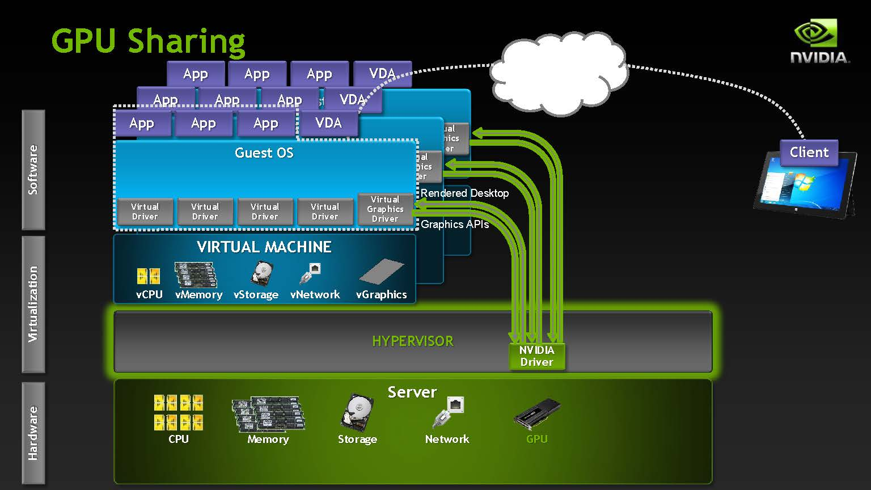
Desktop Virtualization Methods (5)

Slide 69
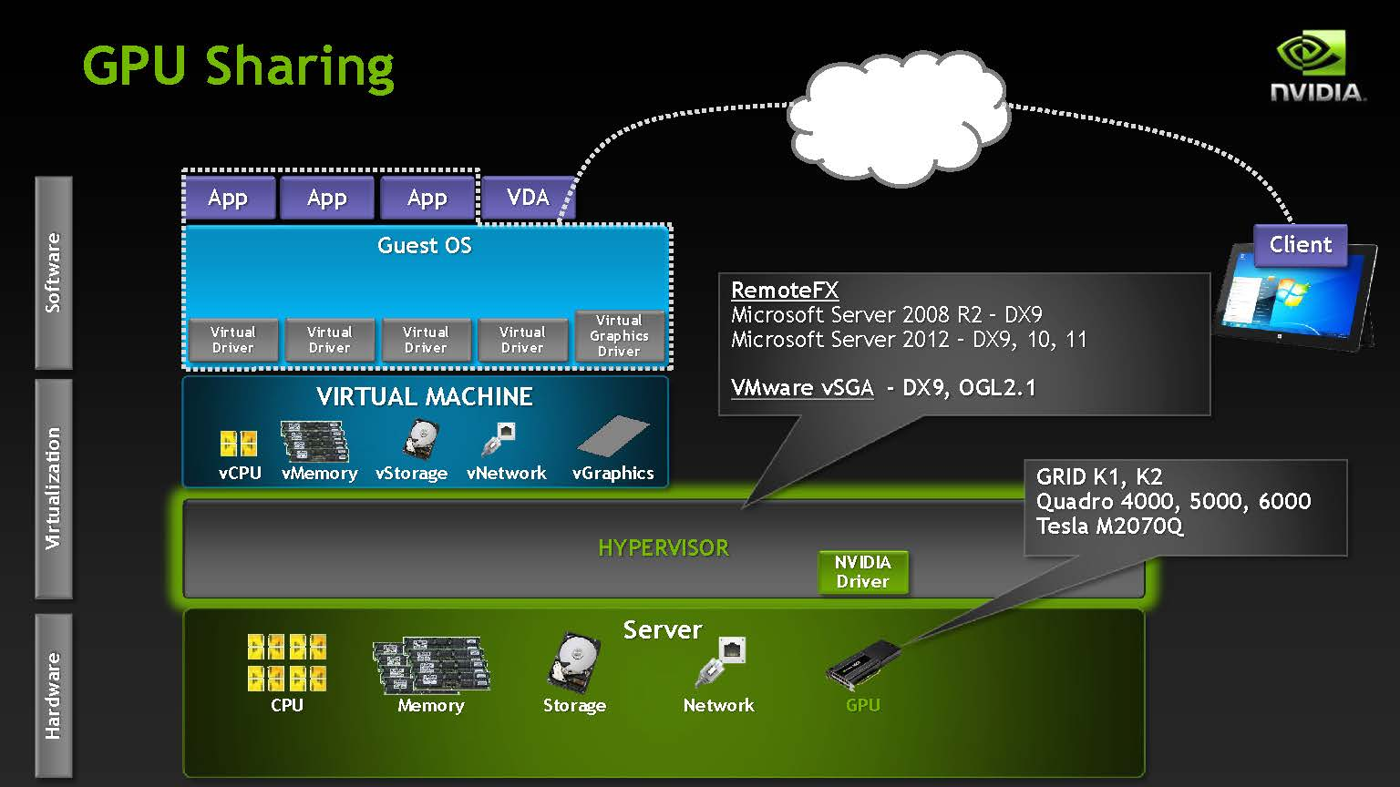
Desktop Virtualization Methods (6)

Slide 70
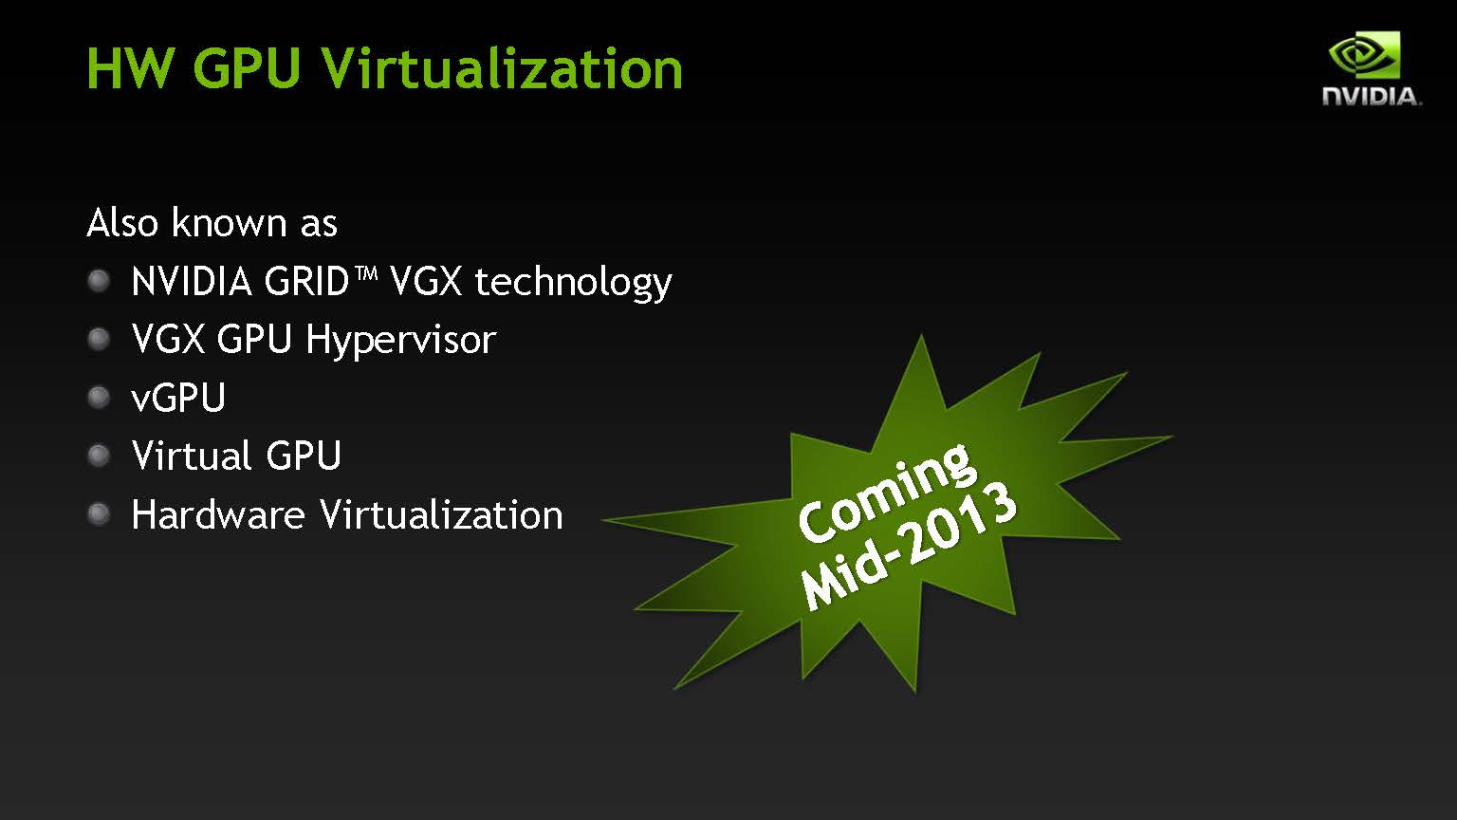
Desktop Virtualization Methods (7)

Slide 71
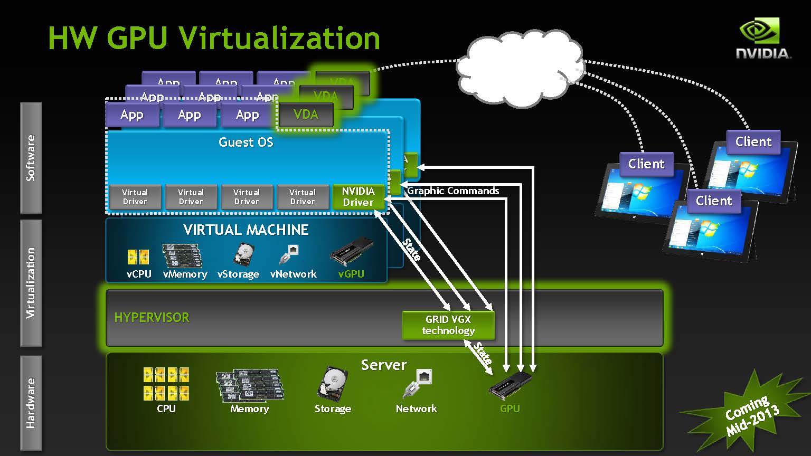
Desktop Virtualization Methods (8)

Slide 72
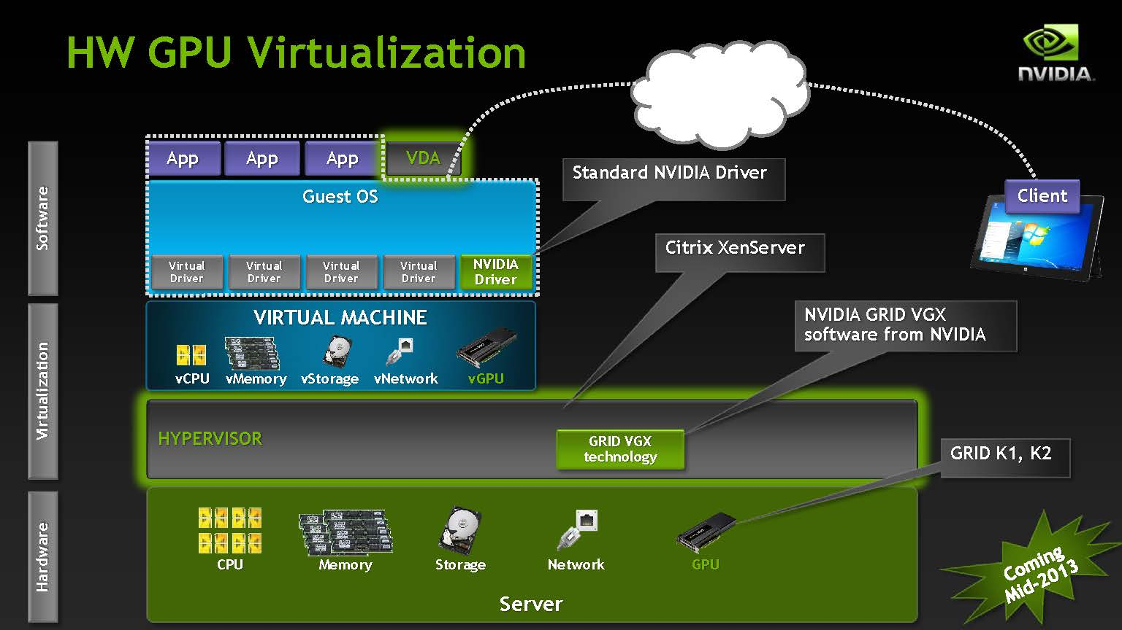
Desktop Virtualization Methods (9)

Slide 73
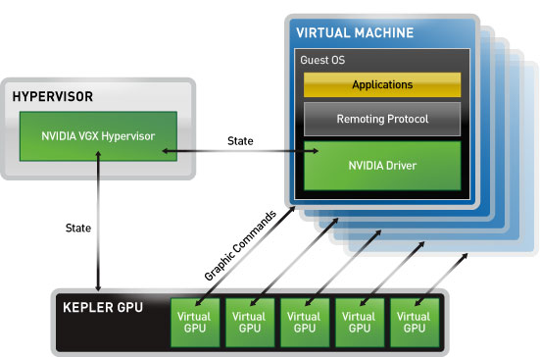
NVIDIA GRID K2 (1)
Hardware feature
  2 Kepler GPUs, contains a total of 3072 cores
  GRID K2 has own MMU (Memory Management Unit)
  Each VM has own channel to pass through to VGX Hypervisor and GRID K2
  1 GPU can support 16 VMs
Driver feature
  User-Selectable Machines: depend on VM requirement, VGX Hypervisor will assign specific GPU resources to that VM
  It can support remote desktop

Slide 74
NVIDIA GRID K2 (2)
Two major paths
  App → Guest OS → Nvidia driver → GPU MMU → VGX Hypervisor → GPU
  App → Guest OS → Nvidia driver → VM channel → GPU
The first path is similar to “Device Emulation”
  Nvidia driver is front-end and VGX Hypervisor is back-end
The second path is similar to “GPU pass-through”
  Part of VMs use specific GPU resources

Slide 75
References

Slide 76
References
Micah Dowty, Jeremy Sugerman, VMware, Inc. “GPU Virtualization on VMware’s Hosted I/O Architecture,” USENIX Workshop on I/O Virtualization, 2008.
J. Duato, A. J. Pe˜na, F. Silla, R. Mayo, and E. S. Quintana-Ort´ı, “rCUDA: Reducing the number of GPUbased accelerators in high performance clusters,” in Proceedings of the 2010 International Conference on High Performance Computing & Simulation, Jun. 2010, pp. 224–231.
Giunta G., R. Montella, G. Agrillo, and G. Coviello. A gpgpu transparent virtualization component for high performance computing clouds. In P. D’Ambra, M. Guarracino, and D. Talia, editors, Euro-Par 2010 - Parallel Processing, volume 6271 of Lecture Notes in Computer Science, chapter 37, pages 379–391. Springer Berlin / Heidelberg, Berlin, Heidelberg, 2010.
A. Weggerle, T. Schmitt, C. Löw, C. Himpel and P. Schulthess, “ VirtGL - a lean approach to accelerated 3D graphics virtualization,” In Cloud Computing and Virtualization, CCV ’10, 2010.
Lin Shi, Hao Chen, Jianhua Sun and Kenli Li, “ vCUDA: GPU-Accelerated High-Performance Computing in Virtual Machines ,” IEEE Transactions on Computers, June 2012, pp. 804–816.
NVIDIA Inc. “NVIDIA GRID™ GPU Acceleration for Virtualization,” GTC, 2013

